Slide 1
CHANGE MANAGEMENT-I
ITIL CHANGE MANAGEMENT BEST PRACTICES
http://www.bmc.com/guides/itil-change-management.html

Slide 2
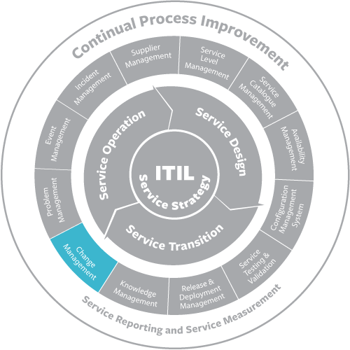
CHANGE MANAGEMENT-I

Slide 3
CHANGE MANAGEMENT-I
ITIL change management is a process designed to understand and minimize risks while making IT changes. Businesses have two main expectations of the services provided by IT:

Slide 4
CHANGE MANAGEMENT-I
The services should be stable, reliable, and predictable.
The services should be able to change rapidly to meet evolving business requirements.

Slide 5
CHANGE MANAGEMENT-I
These expectations are in conflict. The objective of change management is to enable IT service management to meet both expectations—to enable rapid change while minimizing the possibility of disruption to services.

Slide 6
CHANGE MANAGEMENT-I
Types Of Changes
Standard changes are changes to a service or to the IT infrastructure where the implementation process and the risks are known upfront.
These changes are managed according to policies that are the IT organization already has in place.

Slide 7
CHANGE MANAGEMENT-I
Since these changes are subject to established policies and procedures, they are the easiest to prioritize and implement, and often don’t require approval from a risk management perspective.

Slide 8
CHANGE MANAGEMENT-I
Normal Changes
Those that must go through the change process before being approved and implemented. If they are determined to be high-risk, a change advisory board must decide whether they will be implemented.

Slide 9
CHANGE MANAGEMENT-I
Emergency Changes
Arise when an unexpected error or threat occurs, such as when a flaw in the infrastructure related to services needs to be addressed immediately. A security threat is another example of an emergency situation that requires changes to be made immediately.
END

